Slide 1

Copyright, Fair Use, and
Creative Commons
Drawing Assignment
Slide presentation by @AJ_Boston, 2019. distributed under a Creative Commons Attribution 4.0 International
Background image: “Red Panda Ad Pattern” by Sara A. Hutson, May 03, 2017, is licensed under a
Creative Commons Attribution 4.0 License.

Slide 2
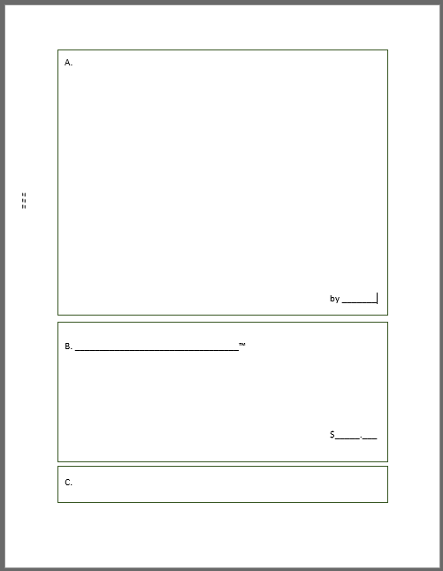

Slide 3
1. Initial Creation (4 minutes)
a. Recall a happy or meaningful childhood memory
b. Pick a single image from that memory
c. Sketch that image into Box A with the Sharpie
d. Credit yourself next to “by”
e. Imagine you are publishing this picture online,
by passing it to your left-hand neighbor

Slide 4
1. Initial Creation (1 minute)
a. OPTIONAL: Review the Creative Commons licenses. Write one next to your name, if you wish
b. Imagine you are posting this picture to your online blog, by passing it to your left-hand neighbor

Slide 5
2. Derivative Work (4 minutes)
a. Imagine you found this drawing online
b. “Downloaded a copy” of it by covering
over it with the tracing-paper
c. If you want to, make something new!
e. Imagine you are posting this picture to your online blog, by passing it to your left-hand neighbor

Slide 6
3. Commercial Uses (4 minutes)
a. Imagine you found this drawing online
b. Think of a commercial activity related
to either picture, or both pictures
c. Write OR Draw your idea in Box B
d. Name or brand it _______™ and price it $_____.____
e. Imagine your are publishing this as an onlie ad, by passing your sheet to your left-hand neighbor

Slide 7
4. Infringement (4 minutes)
a. You are an attorney representing the artist from Box A
b. Read the Copyright and Fair Use language on page 2
c. In Box D, write a take-down notice to the artist
of the tracing-paper sketch, because their derivative
work is “violating your client’s copyright”
d. Send this letter to the derivative work artist’s agent by passing your sheet to your left-hand neighbor

Slide 8
5. Fair Use (4 minutes)
a. You are an agent representing the tracing-paper artist
b. Read the take-down notice delivered to you
c. In Box E, write a counter-argument that the
derivative tracing-paper sketch fall under Fair Use

Slide 9
6. Exhibition
a. Take the sheet and tape it to the wall
b. Look over the other drawings
c. Put a sticker in Box C of two of those sheets

Slide 10
7. Student Descriptions
Commercial Uses
Deliver your best business pitch!
Derivative Work
Describe your drawing & its incorporation of the original
Initial Creation
Discuss the meaning of your sketch

Slide 11
8. Student Justifications
Commercial Uses
Would you owe credit to or need permission
from either of the artists?
Derivative Work
Would you owe need permission from artists?
Did you give any attribution? Why or why not?
Agent & Attorney
Please read or summarize your statements.
Did you agree with the arguments that
you were tasked with making?

